Slide 1
CIND820 Final Project Predicting Popularity of Open Datasets
Patrick Little
500933106

Slide 2
Introduction & Problem Statement
Open.Canada.ca, the Government of Canada’s Open Data Portal contains over 85,000 open datasets or open information resources. These datasets are published by many different government organizations and covers subject matter on a variety of topic areas.
On Open.Canada.ca certain datasets receive several thousand downloads per month, while others receive little to no usage on a monthly basis.
Having the ability to predict the popularity of a dataset at the time of publication would enable open data publishers to surface the most relevant and in demand content to users on the open data portal, as well as determine which newly released datasets to promote via other channels such as social media.
The aim of my project was to develop a classifier to analyze the metadata of a newly published dataset on Open.Canada.ca and predict a popularity category that will correspond to the popularity of the dataset as determined by the number of downloads.
Notes:
Open.Canada.ca, the Government of Canada’s Open Data Portal contains over 85,000 open datasets or open information resources. These datasets are published by many different government organizations and covers subject matter on a variety of topic areas. On Open.Canada.ca certain datasets receive several thousand downloads per month, while others receive little to no usage on a monthly basis.
Having the ability to predict the popularity of a dataset at the time of publication would enable open data publishers to surface the most relevant and in demand content to users on the open data portal, as well as determine which newly released datasets to promote via other channels such as social media.
In the last 12 months an average of 365 new open datasets were released each month on Open.Canada.ca.
The velocity of data release means that it would require significant effort from a person to monitor the release of all these new datasets and use their intuition or some other heuristic to determine what newly released datasets to promote or recommend to users. As such, this problem is well suited to be augmented with a predictive model that can identify newly published datasets at the time of publication which are likely to be popular.
The aim of my project was to develop a classifier to analyze the metadata of a newly published dataset on Open.Canada.ca and predict a popularity category that will correspond to the popularity of the dataset as determined by the number of downloads.
The analysis within this paper was conducted using R, and leverages the tidymodels framework for model building, training, and evaluation.
“Open Government Analytics.” Open Government, Government of Canada, 1 February 2021, http://open.canada.ca/en/content/open-government-analytics

Slide 3
Dataset
My project relies on two source datasets.
The first dataset is the metadata catalogue from Open.Canada.ca. The Government of Canada publishes an open dataset of the metadata for all the data and information resources available on Open.Canada.ca. This dataset is updated every night with the latest data. This dataset is a JSON lines dataset, where each line of the file is a JSON object representing the metadata of an individual dataset on Open.Canada.ca. As of 2 Feb 2021, there were 87,331 metadata records contained within the metadata catalogue.
The second dataset to be used is a listing of the number of downloads from Open.Canada.ca for the last 12 months, by dataset. This dataset is published as an .xls workbook and is updated on the 1st business day of each month with data from the previous 12 months. This dataset is not packaged in a convenient way for analysis as this excel workbook contains 88 tabs.
https://open.canada.ca/data/en/dataset/c4c5c7f1-bfa6-4ff6-b4a0-c164cb2060f7

Slide 4
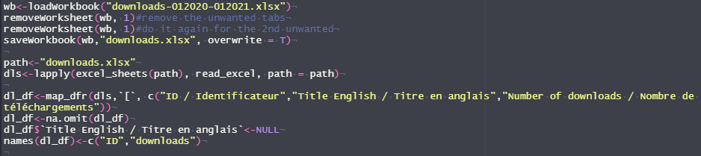
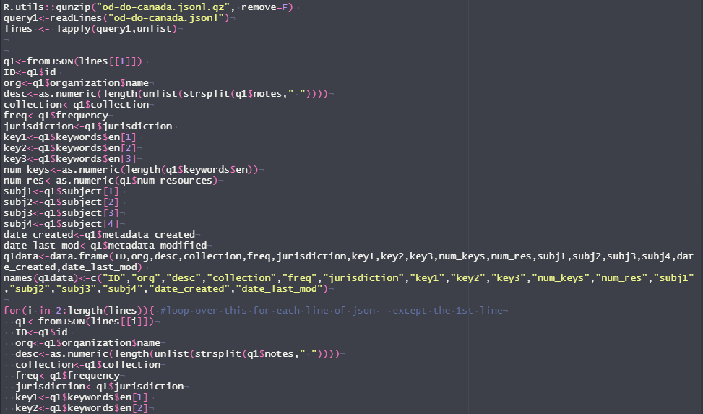
Dataset Loading
Turning the 88 tabs into a dataframe.
Consuming the JSON lines object.

Slide 5
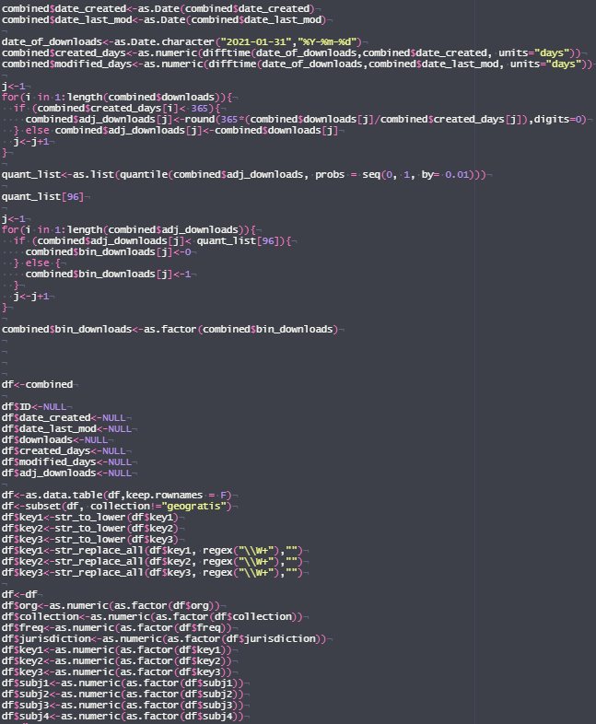
Data manipulation
Taking the dates and converting them to relative numbers of days
This is a step that I revisited numerous times throughout the project.
In earlier iterations of the model I was using a One Hot encoding for the factor variables, which was causing model training times in excess of 12 hours.
Directly encoding our factors as numeric allowed us to remove the One Hot encoding and get a model training time of less than 2 hours.
scaling the number of downloads to 1 year for datasets less than a year old
Binary encoding the popularity based on our percentile threshold
Getting rid of columns we won’t use
Subsetting the data to remove a collection type
Encoding our factor variables as numeric

Slide 6
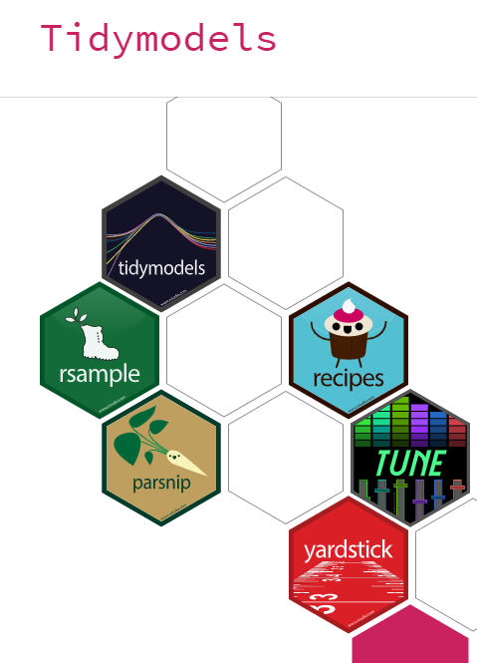
Models Approach
Using tidymodels within R we can tackle the end-to-end model in an easy to understand and work with framework.
rsample -> setup test and training splits, setup our cross validation
parsnip -> setup model specification
Tune -> tune our hyperparameters
Tidymodels -> setup a workflow

Slide 7
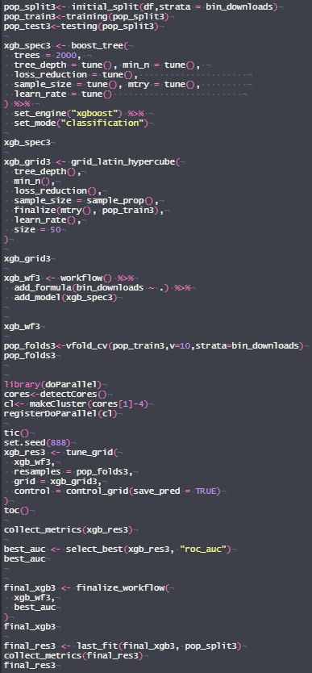
Model Approach Applied
Setting up splits
Setting up model spec
Using tidymodels we were able to setup our splits, define our model specification, setup a model workflow, and tune our hyperparameters.
Setup tuning grid
Defining a workflow
Defining the cross validation
Tuning our hyperparameters
Selecting our best combination of hyperparameters
Finalizing the workflow
Appling our model to the test data

Slide 8
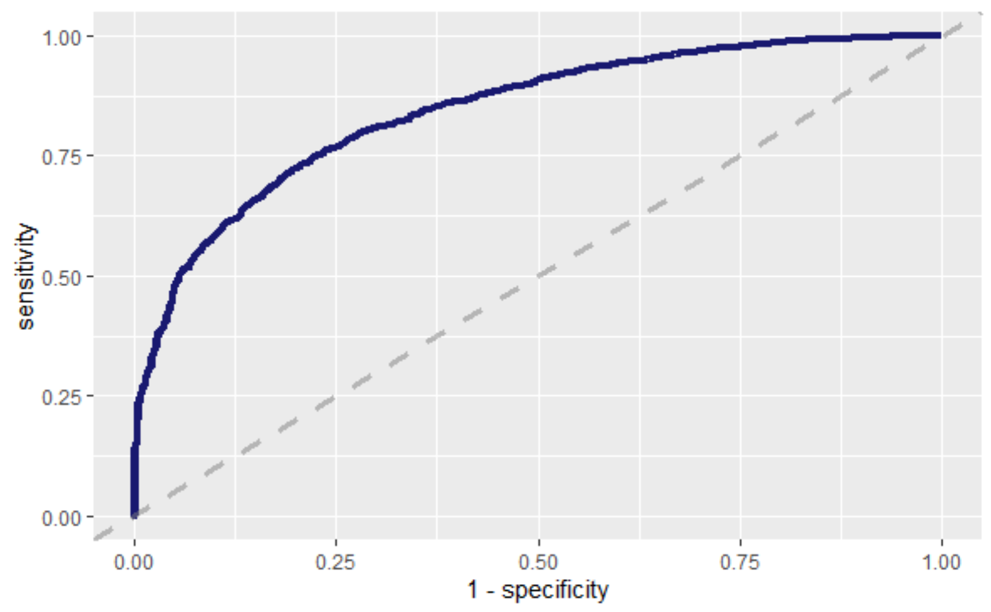
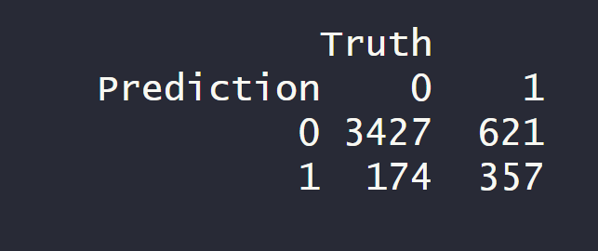
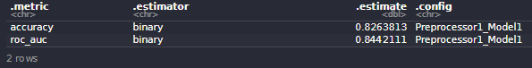
Results
We were able to achieve a model ROC_AUC of 84.42% and an accuracy of 82.63%.
Compared to another paper attempting to solve the same research problem, we significantly out preformed the other paper. 69.85% accuracy with the Naïve Bayes Classifier vs. 82.63% with our model.

Slide 9
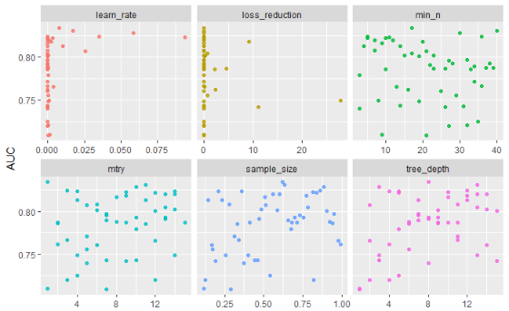
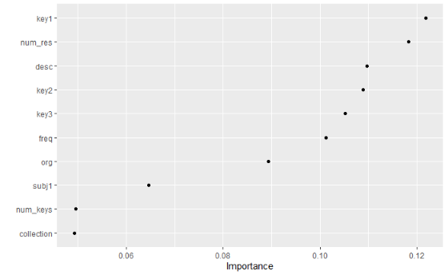
Further Exploration of the Results
We can examine the hyperparameter values tried during the tuning process and gain an understanding of how the hyperparameter values affected the various outcomes.
We can also look at a Variable Importance Plot to gain an understanding of which predictor variables contributed the most to our model.

Slide 10
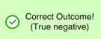
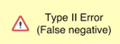
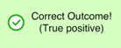
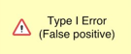
Conclusions
Even with a model accuracy of over 82% the number of type two errors is still relatively high.
Based on this result one can assume that certain datasets with the potential to be popular remain undiscovered, while a small proportion of non-popular datasets may be surfaced to stakeholders as potentially popular.
For our research problem, we are willing to accept significant error of both type 1 and type 2 types, as the stakes are relatively low, the aim is to surface relevant content to promote, however we want to maximize the reliability of our predictions.
Prediction / Truth | False – Not Popular download | True – Popular download
Predicted not popular | Correct prediction | Here datasets that are popular are not identified by the model as being popular, therefore the model will not highlight these to the relevant stakeholders at the time of creation.
Predicted popular | Here datasets that are not popular are identified by the model as being popular, therefore the model will be feeding bad predictions to the stakeholders. | Correct prediction

Slide 11
Putting our model in production
In order to capitalize on the model developed as part of this research an initial attempt to put this model into production was made. This step was not fully completed during the time allotted to the project.
The data pipeline required for this step has successfully been implemented but modifications to our model need to made to instruct the model how to reliably deal with new factor levels from the data that the model has not been trained on.
This required modification of the model will be required before the production model will be suitable to feed popularity predictions to our stakeholders.
The model in production has been running hourly thus far and outputting predictions to a .CSV uploaded on Github. The code for this portion is available at: https://github.com/PatLittle/Ryerson-Big-Data-Analytics-Final-Project/blob/master/final-report/model-in-production.R and the workflow definition for Github actions is available at https://github.com/PatLittle/Ryerson-Big-Data-Analytics-Final-Project/tree/master/.github/workflows
Using the CKAN API from Open.Canada.ca we can return a list of newly added datasets by using the /action/package_search command with a parameter to sort by recently added datasets. We can then extract the newest dataset added from the JSON object returned. Using the code developed to do the feature extraction to generate the initial dataset for the research we can fit the new datasets into a format that is consumable by our model.
We can then simply use the Predict function within R and feed in our trained model object, and our new data as arguments to receive a prediction of popularity. This code can be easily packaged into a standalone .R script that can run automatically.
Using Github actions we can dynamically provision a Ubuntu virtual machine and run our production model at a scheduled frequency. We can control the frequency and other parameters by providing a yaml specification file that defines this workflow. We can also save our prediction outputs to a file to reference at our convenience.

Slide 12
Questions from the Professors

Slide 13
Really enjoyed the program!

